Slide 1
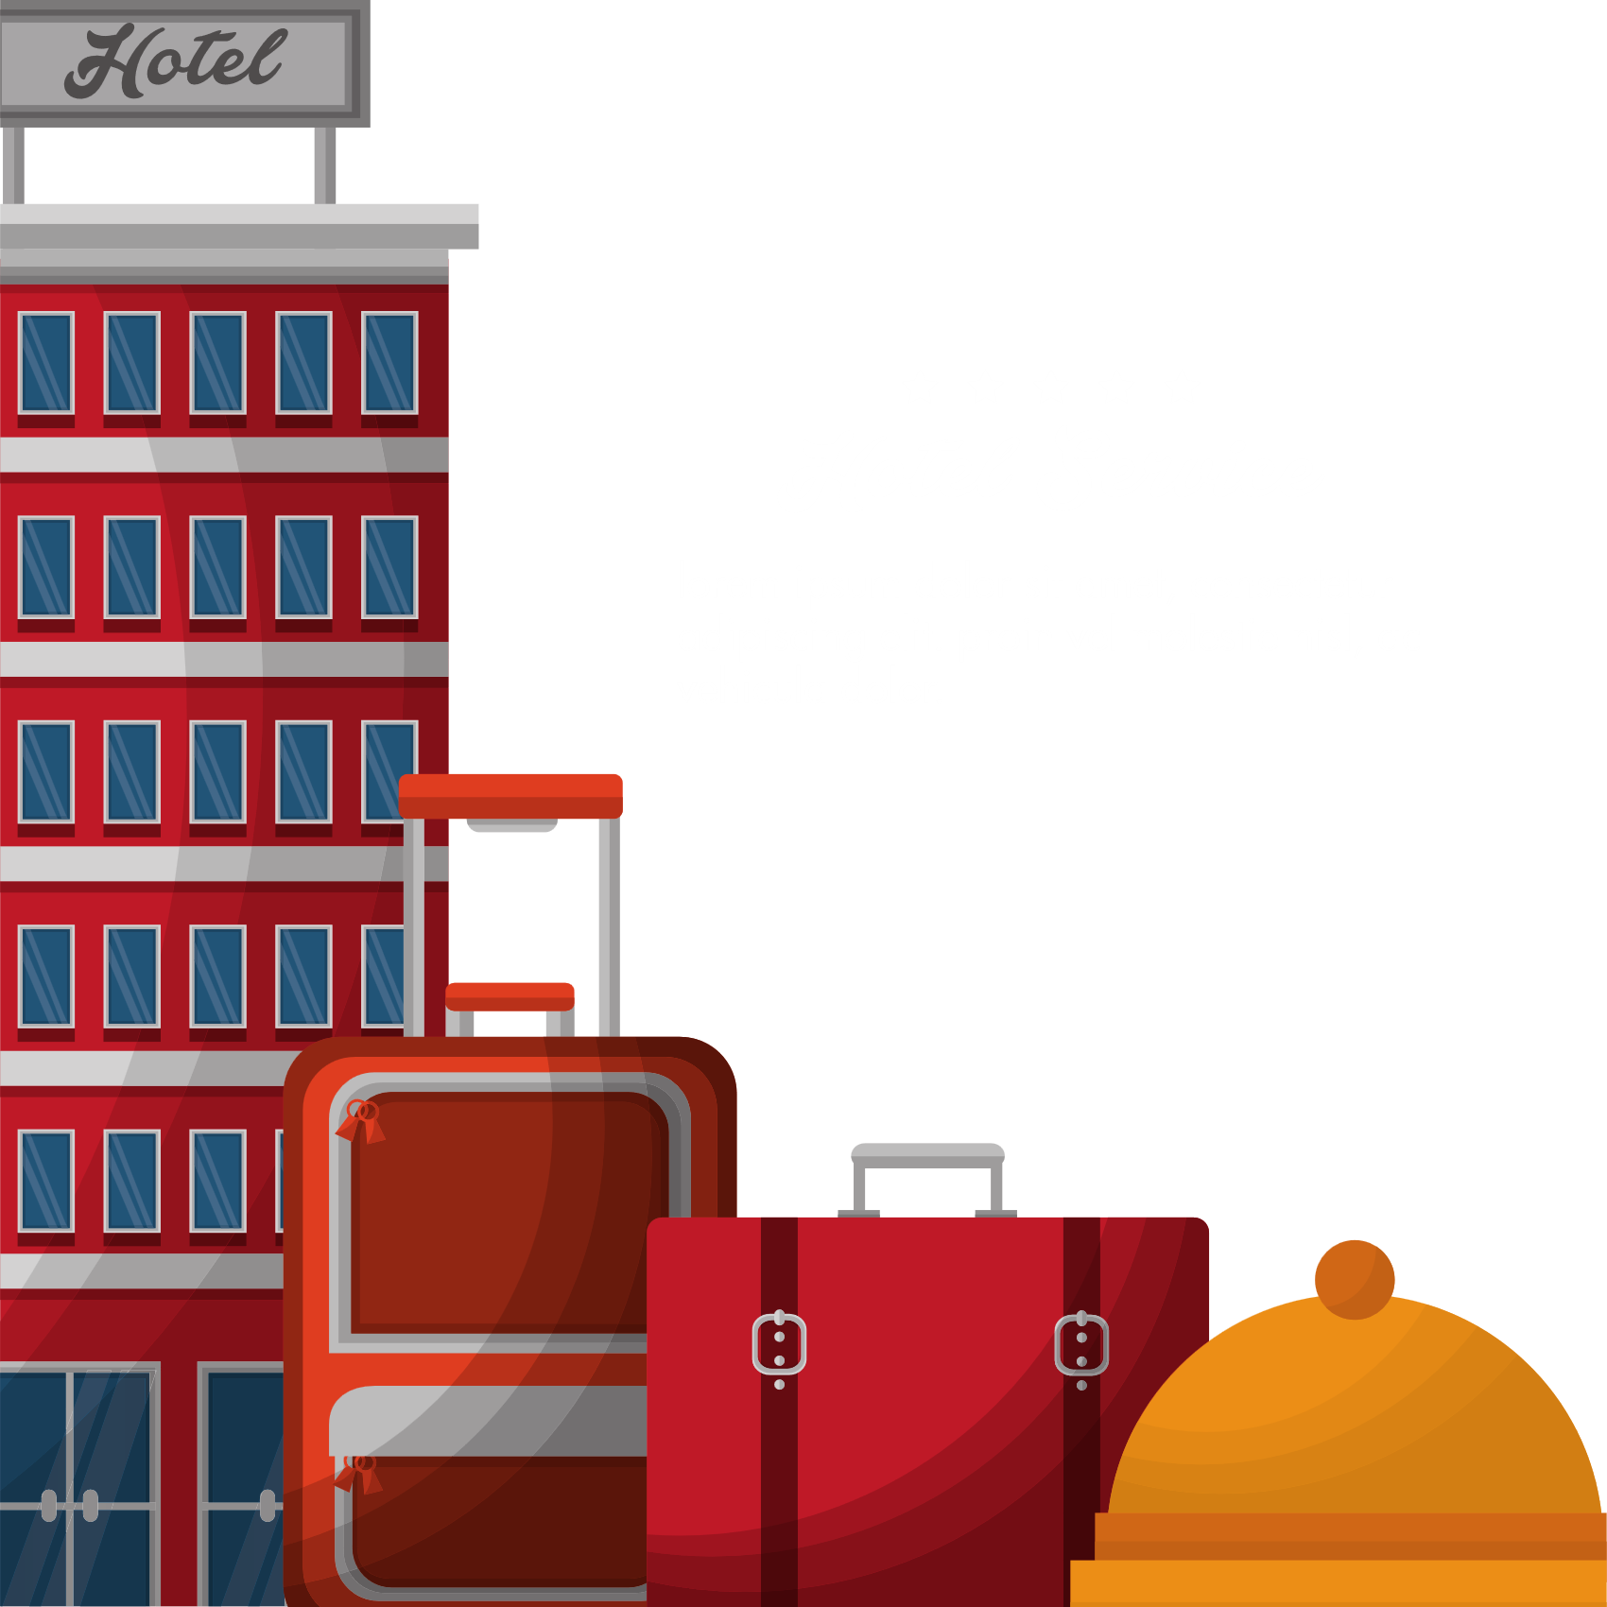
HYPER HOTELS
Once upon a time, a chain of hotels hired three data analysts..

Slide 2

Operations

Slide 3
Problem: The Operations team is facing disruptions due to an increase in cancellations, which leaves rooms unrented for days, causing issues with general service planning.
Goal:
To develop a data-driven approach that minimizes cancelation impacts and enhances operational efficiency.

Slide 4
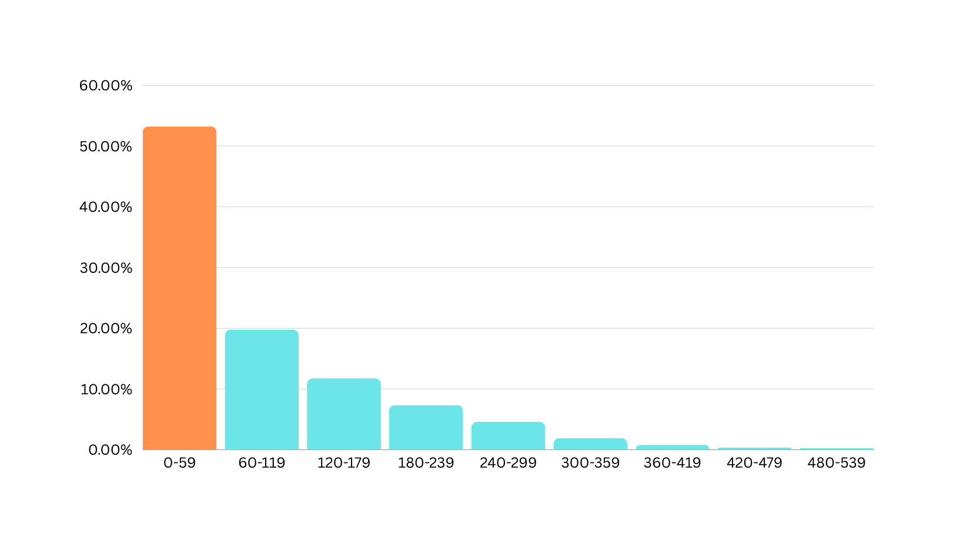
Key Insights from Data:
Cancelation Window: 53% of cancelation occurs within 0-59 days of arrival date.
Days before arrival Vs Total Cancelation
53.23%

Slide 5
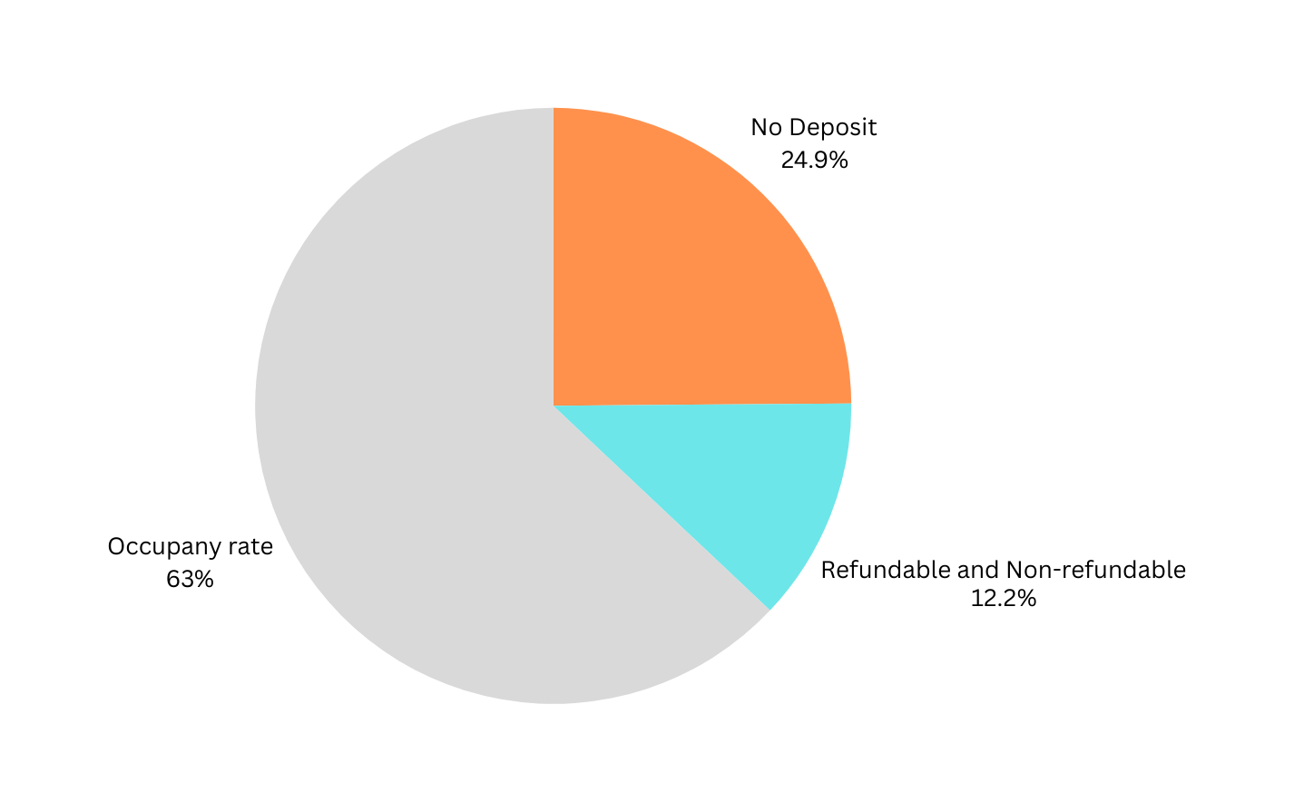
Deposit Type Vs Cancelation Rate

Slide 6
Segment of Cancelations:
TA/TO distribution channel: 40,152 cancelations, approximately 90.7% of the total cancelations(44,224).
Online TAs: Accounts for nearly half 47% of cancelations(40,152).

Slide 7
Short-Stay Cancelations: Short stays (0-4 nights) have a high cancellation rate of 62%.

Slide 8
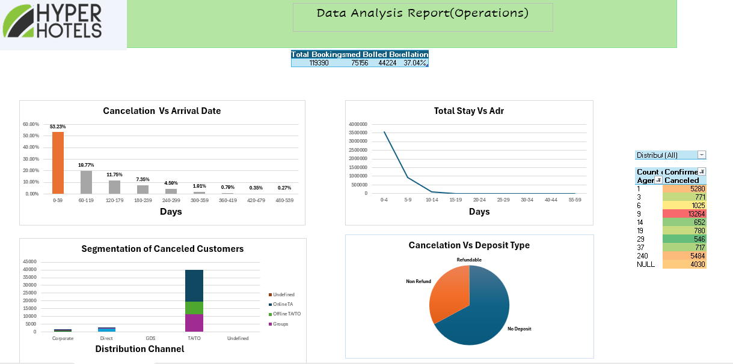

Slide 9
Potential Causes:
Booking Flexibility & Cancellation Policies:
Lenient cancelation policies for short stays might encourage last-minute cancellations.
Customer Behaviour Patterns:
Customers booking short stays may have alternative accommodation options or flexible travel plans, making them more likely to cancel.
Lack of Commitment for Short Stays:
Short stays are perceived as less financially committing, leading to higher cancellation rates.
Some customers might book short stays as a backup option and cancel if plans change.
Booking Lead Time:
Last minute booking increases the likelihood of cancellations due to sudden plan changes or emergencies.

Slide 10


-How can we lower the current cancellation rate?

Slide 11


-How can we optimize the hotel's need for restaurant staff?

Slide 12


How can we improve our marketing performance?

Slide 13
Proposed Recommendations:
Implement mandatory deposits for bookings within 100 days of the arrival date.
Provide rebooking options.
Remind customers at regular intervals to reduce last-minute cancelations and no-shows.
Data-Driven Staffing Adjustments.
Collaboratee with Online Travel Agencies (OTAs) to implement stronger booking commitments.

Slide 14




Operation conclusion
REBOOK NOW

Slide 15
Conclusion
Summary: By implementing cancellation policies, introducing penalties, and improving communication with guests, the operations department can better manage cancellations, optimize staffing, and increase room occupancy.
Next Steps: Track cancellation patterns over time to time, to assess the effectiveness of these strategies and continue refining operational adjustments based on data-driven insights.

